Slide 1
Image Processing
& Face Recognition
Aditya & Youssef
BUS 212A, Prof. Namini

Slide 2


Why did we choose this problem?
Notes:
I was recently in India, well before corona to attend a wedding. As you might imagine, it was a grand wedding with many events. A week after it was over, we were bombarded with all the photos. To be honest, I was interested in the photos in which I was there. So I had to manually go through all of them and save the ones in which I was there. This is when I thought, would be cool to put all images in the system and it would just throw out the ones I want. We are trying to achieve something around this.

Slide 3



Problem Statement
“The problem is Image Classification, more specifically, Face Classification”
WE DID IT ON OUR OWN
Classification | Regression
Classify faces to their owner in a supervised setting. Dataset for 115 images for 5 Celebrities. (Kaggle) | Predict the age of a person from a picture of the face. Dataset of 10,000 images with their age. (Kaggle)
Notes:
Youssef

Slide 4
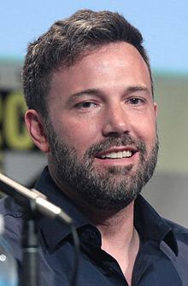
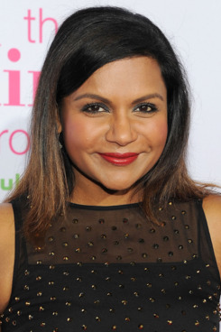
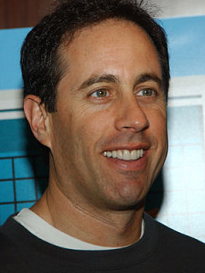
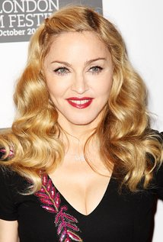
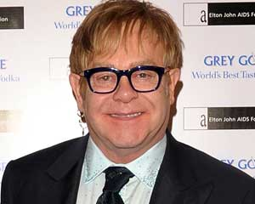
Data:
115 Images for 5 Celebrities:
Ben Affleck Elton John Jerry Seinfeld Madonna Mindy Kaling

Slide 5
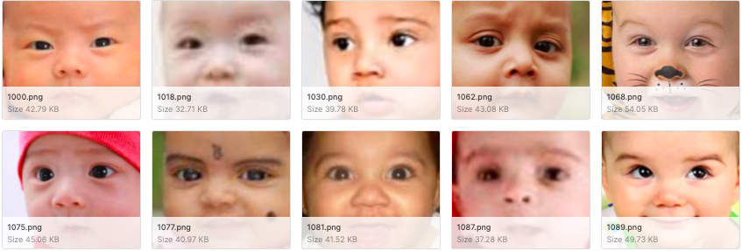
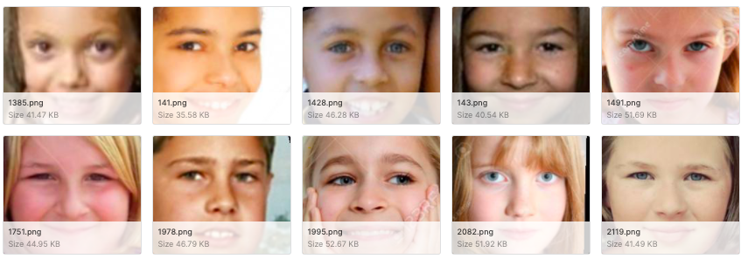
Data Cont’
10,000 images for people aged from 1 - 100
Age = 1
Age = 2
Age = 9
Age = 10
.
.

Slide 6
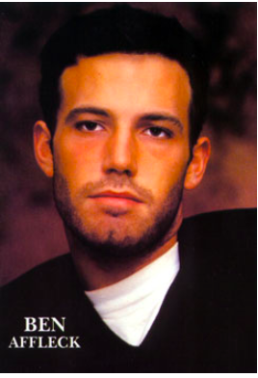
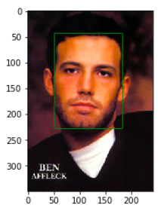
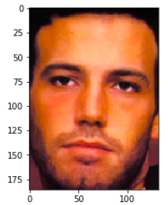
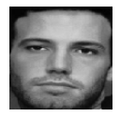
Data Description & Preparation
Preparation steps (The same for both datasets)
Convert colors and resize
Face Detection, MTCNN
Face Cropping
Notes:
Youssef

Slide 7
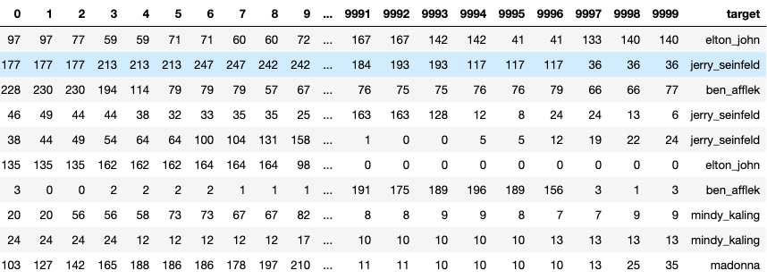
Data Preparation Cont’
Final product after flattening them:

Slide 8
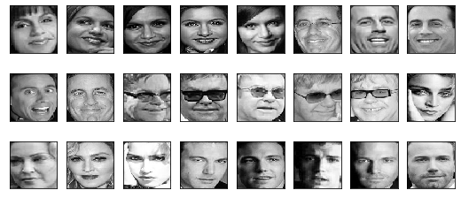
Original Faces
Notes:
These are the final origal faces that we get after the data transformation. On this data we run the PCA. Lets see how that goes.

Slide 9
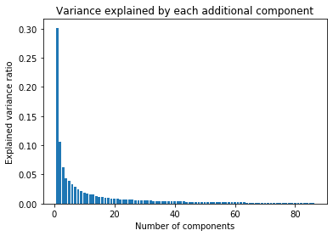
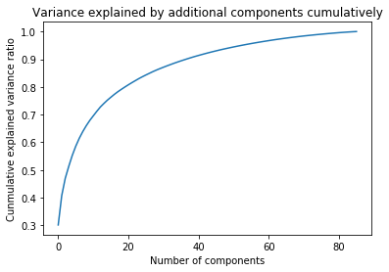
Dimensionality Reduction
Principal Component Analysis
Notes:
For dimensionality reduction, we used PCA. First we had to find out the number of components that we want to work with.We do this using explained variance ratio. As we can see from the graphs, at around 57 components we start to achieve higher than 96% explained variance ratio. This is something we felt comfortable working with.

Slide 10
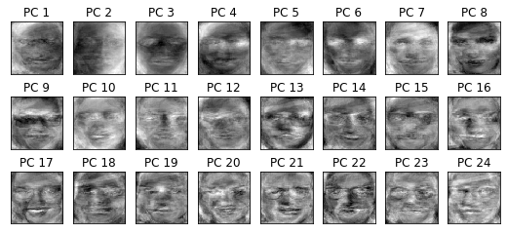
Eigen Faces
Notes:
We printed the eigenfaces to get a understanding of which features has the most variance. As you can see features like spectacles,mustaches,eyes have a lot of variance in them. Yes, it looked creepy to us too.

Slide 11
Classification Methods | Accuracy
SVC with PCA | 72.76%
SVC without PCA | 73.45%
KNN | 64.55%
Logistic Regression | 75.79%
Linear Discriminant Analysis | 76.00%
Random Forest | 62.58%
Gaussian Naive Bayes | 61.72%
Ensemble | 74.55%
With Monte-Carlo Simulation
& Cross Validation
Notes:
We were not completely satisfied with the PCA method. So we decided to do other methods too. After some research, we figured out the Linear Discriminant analysis works well with facial recognition. We then decided to use the ensemble technique. So we used SVC,PCA,KNN,Logistic Regression,LDA,Random Forrest and Naive Bayes for this. We also cross validated to find the best k in KNN and the best c in SVC. As you can see ensemble does not provide with the highest accuracy. But running individual classifier had a lot of variance between different runs. Since the accuracy for ensemble is only slightly lower, we feel more comfortable with the Ensemble technique. To get to these numbers, we did a monte carlo simulation, by running all the methods a 100 times and taking the mode for the answers. SVC-support vector machine

Slide 12
Regression Algorithms
To predict the age, we regressed the images on the age:
Linear Regression
Ridge
Lasso
Support Vector Regression
Random Forest

Slide 13
Regression | MSE | R^2
Support Vector Regression | 288.6 | 0.56
Ridge Regression | 417.9 | 0.21
Lasso Regression | 277.7 | 0.47
Random Forest | 321 | 0.39
Linear Regression | 421.9 | 0.19
Ensemble | 345.4 | 0.36
With Monte-Carlo Simulation
& Cross Validation

Slide 14
Conclusion
We classified faces to their owners with ~75% accuracy.
We regressed images to their age, not as good.
Insights:
Working with images is a lot harder than other data.
Running time is usually in hours 😩.
There are so many moving parts in dealing with images
Deep learning is probably better than classical ML algorithms.

Slide 15
Thank You
Aditya & Youssef
BUS 212A, Prof. Namini

